Slide 1
ILA (Integrated Logic Analyzer) For FPGA Debugging/Chip Scope
https://www.xilinx.com/support/documentation/sw_manuals/xilinx2018_2/ug908-vivado-programming-debugging.pdf

Slide 2
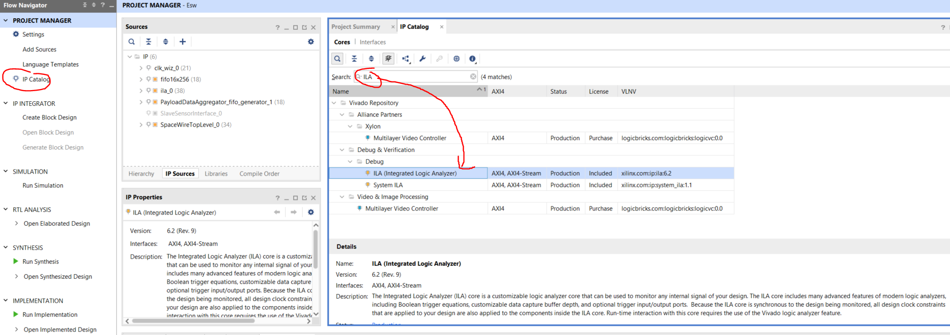
How to Create an ILA Core

Slide 3
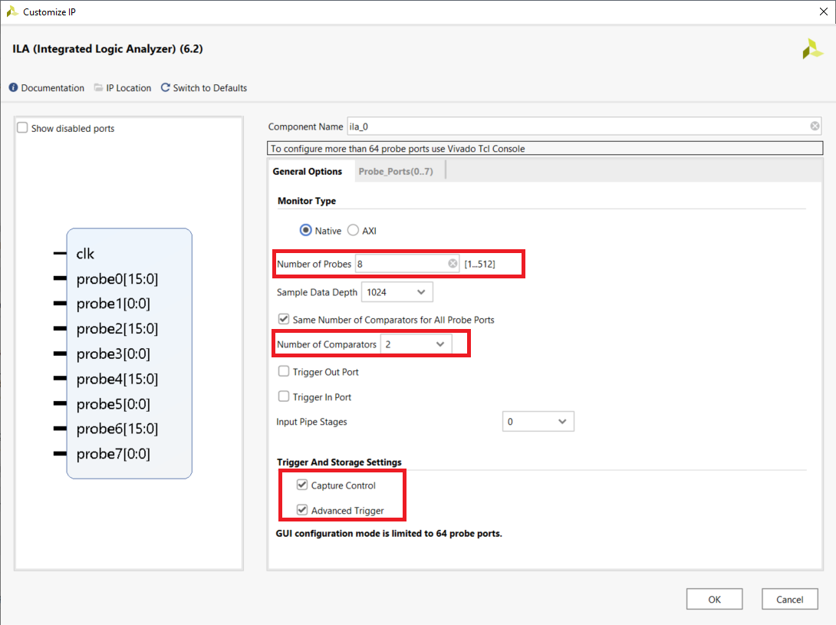
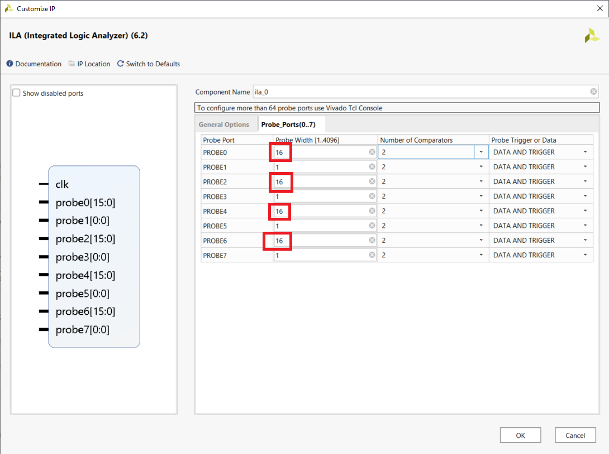
Example ILA core

Slide 4
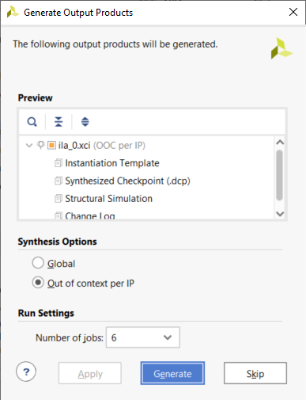
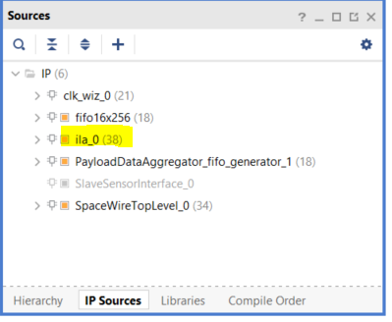
Generate ILA Core

Slide 5
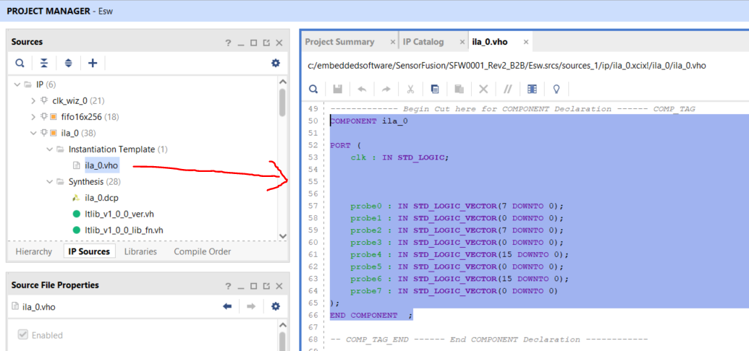
Obtaining the Instantiation Template of the Component

Slide 6
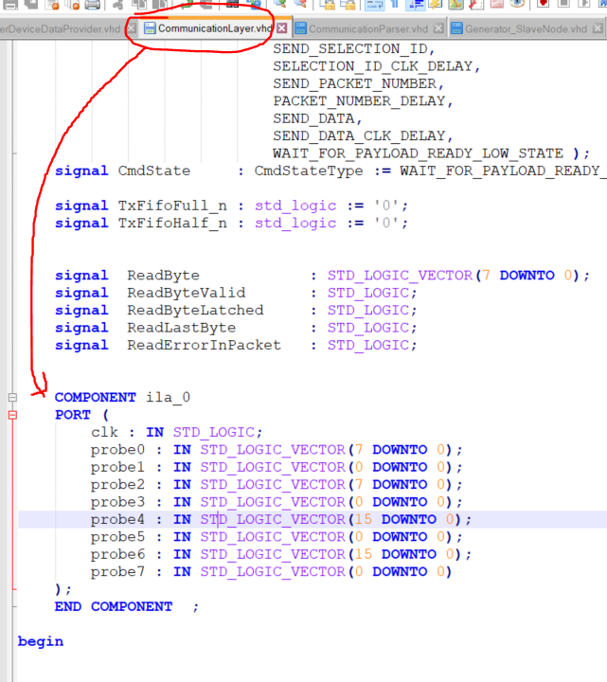
Insert template to desired location to sample & trigger signals

Slide 7
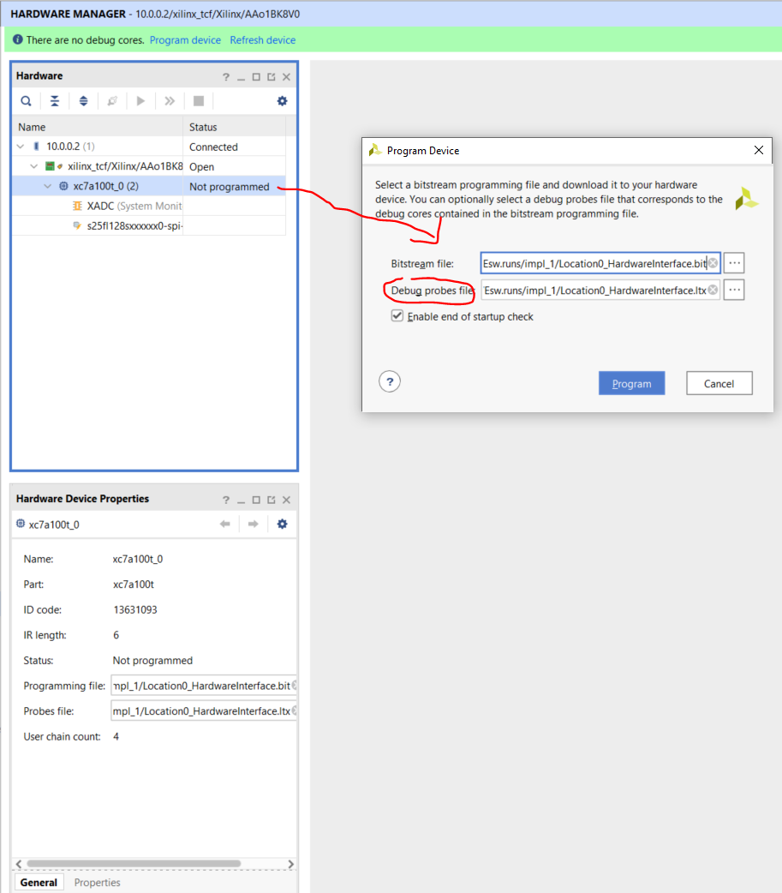
Xilinx on how to use .ltx file for debugging

Slide 8
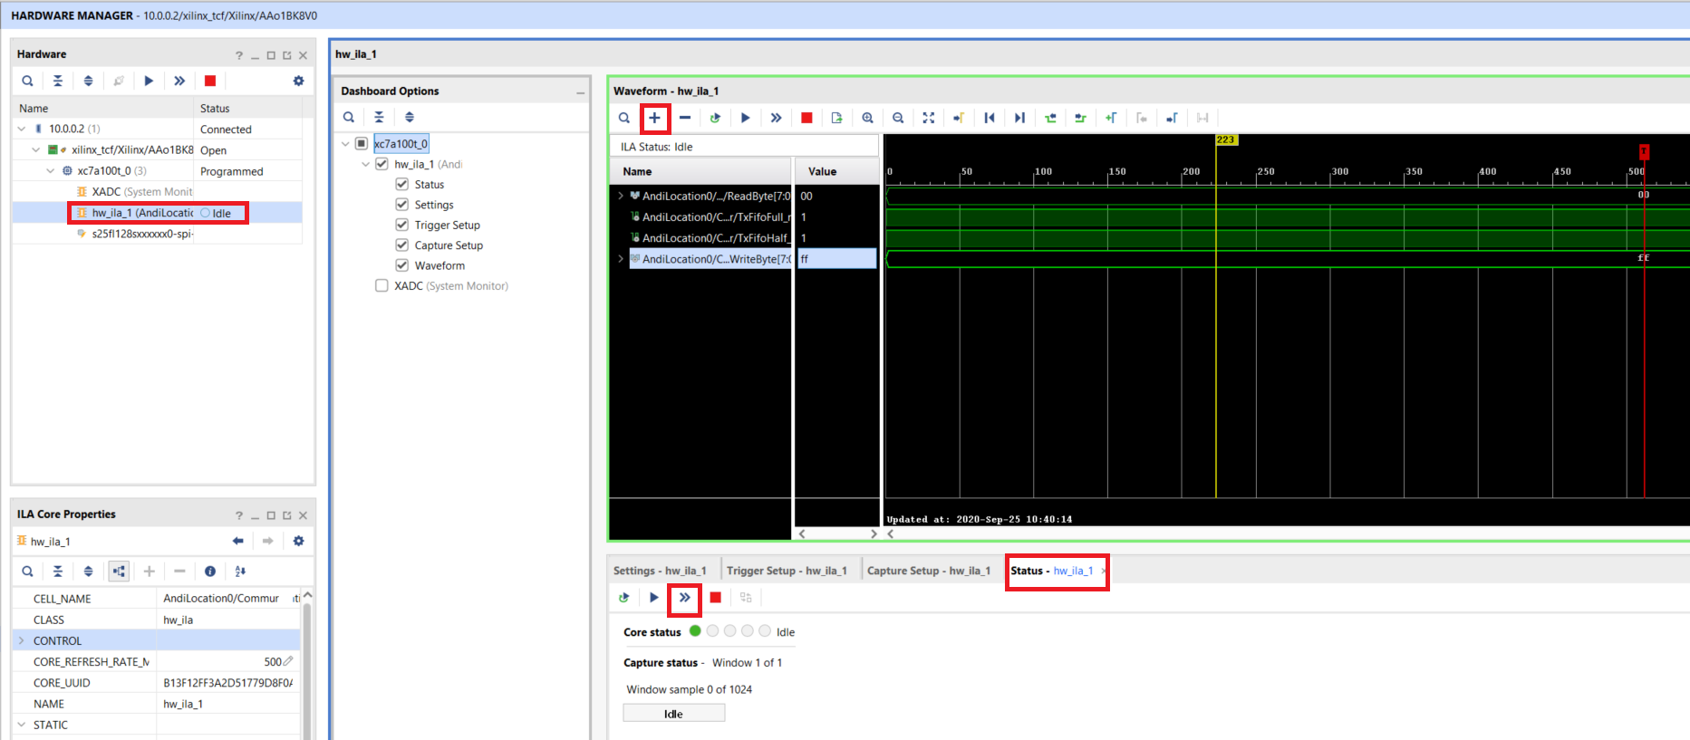
Xilinx on how to use .ltx file for debugging
Slow down JTAG frequency for the device target if ILA fails to arm and deliver waveforms

Slide 9
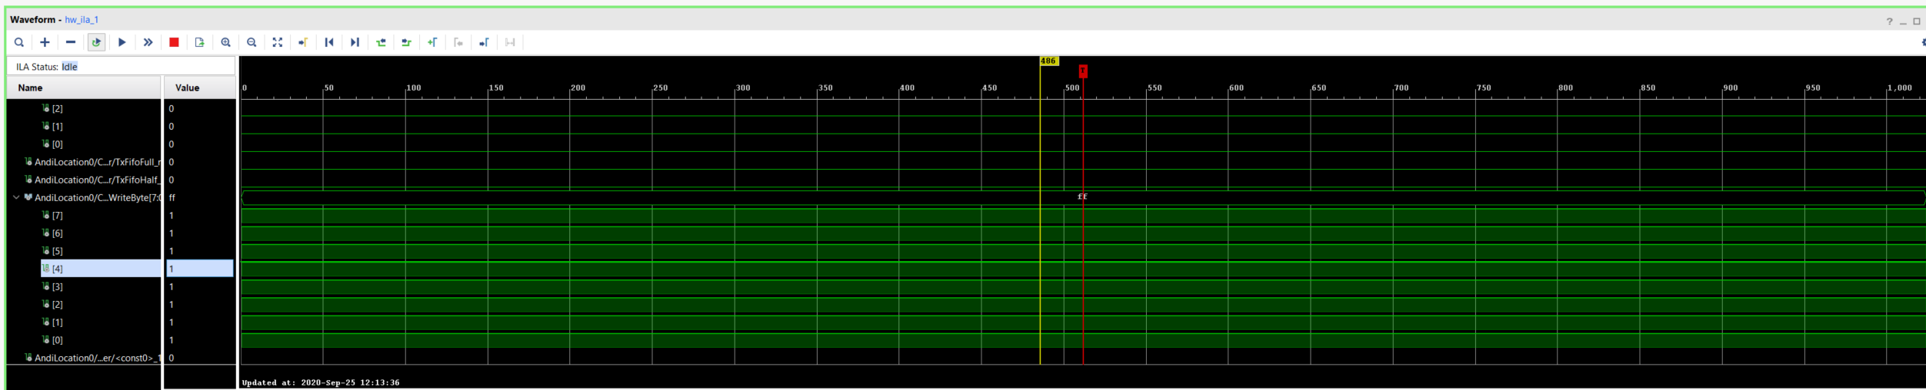
CLK input to ILA’s Rising Edge is the Samples in ILA
https://forums.xilinx.com/t5/Implementation/Change-scale-in-ILA-waveforms-time-axis/td-p/701210
https://forums.xilinx.com/t5/Virtex-Family-FPGAs-Archived/how-to-display-clock-in-chipscope-using-ila-core/td-p/55113
1,000 samples
CLK_in to ILA = 100 MHz (10 ns period)
Sample depth = 10 ns x 1,000 samples = 10 us

Slide 10
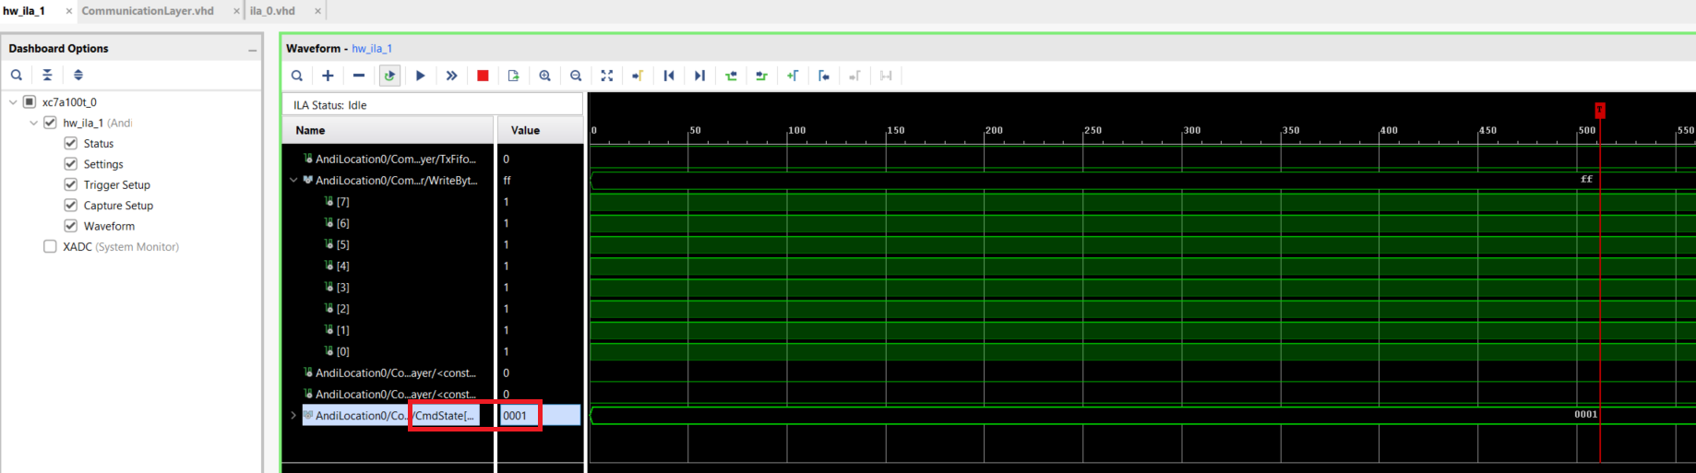
State Machine conversion to Std Logic Vector One-hot for ILA Debugging

Slide 11
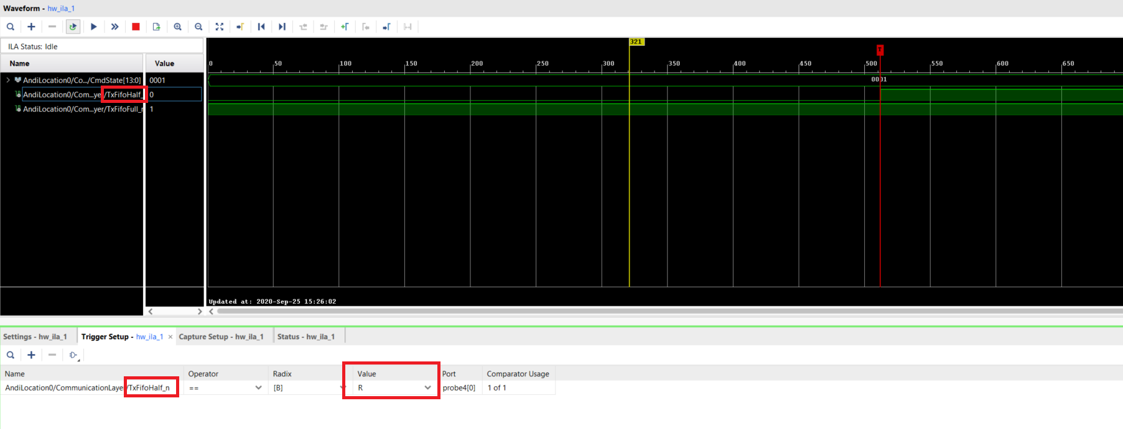
Set for Sample & Triggering on a signal’s Rising or Falling Edge
TxFifoHalf_n is sampled & triggered on rising edge

Slide 12
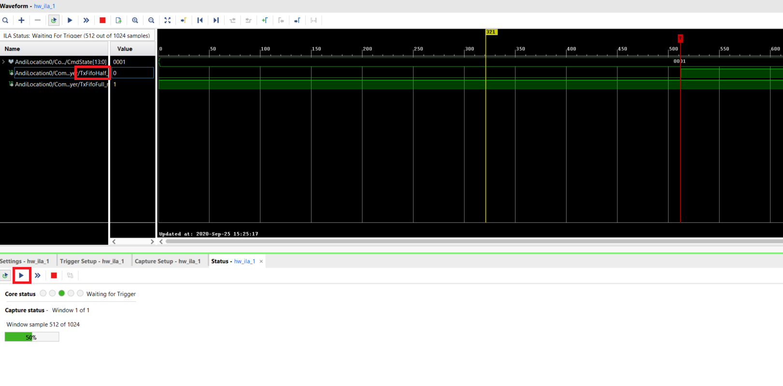
Sample & Triggering on a signal’s Rising Edge
TxFifoHalf_n is sampled & triggered on rising edge

Slide 13
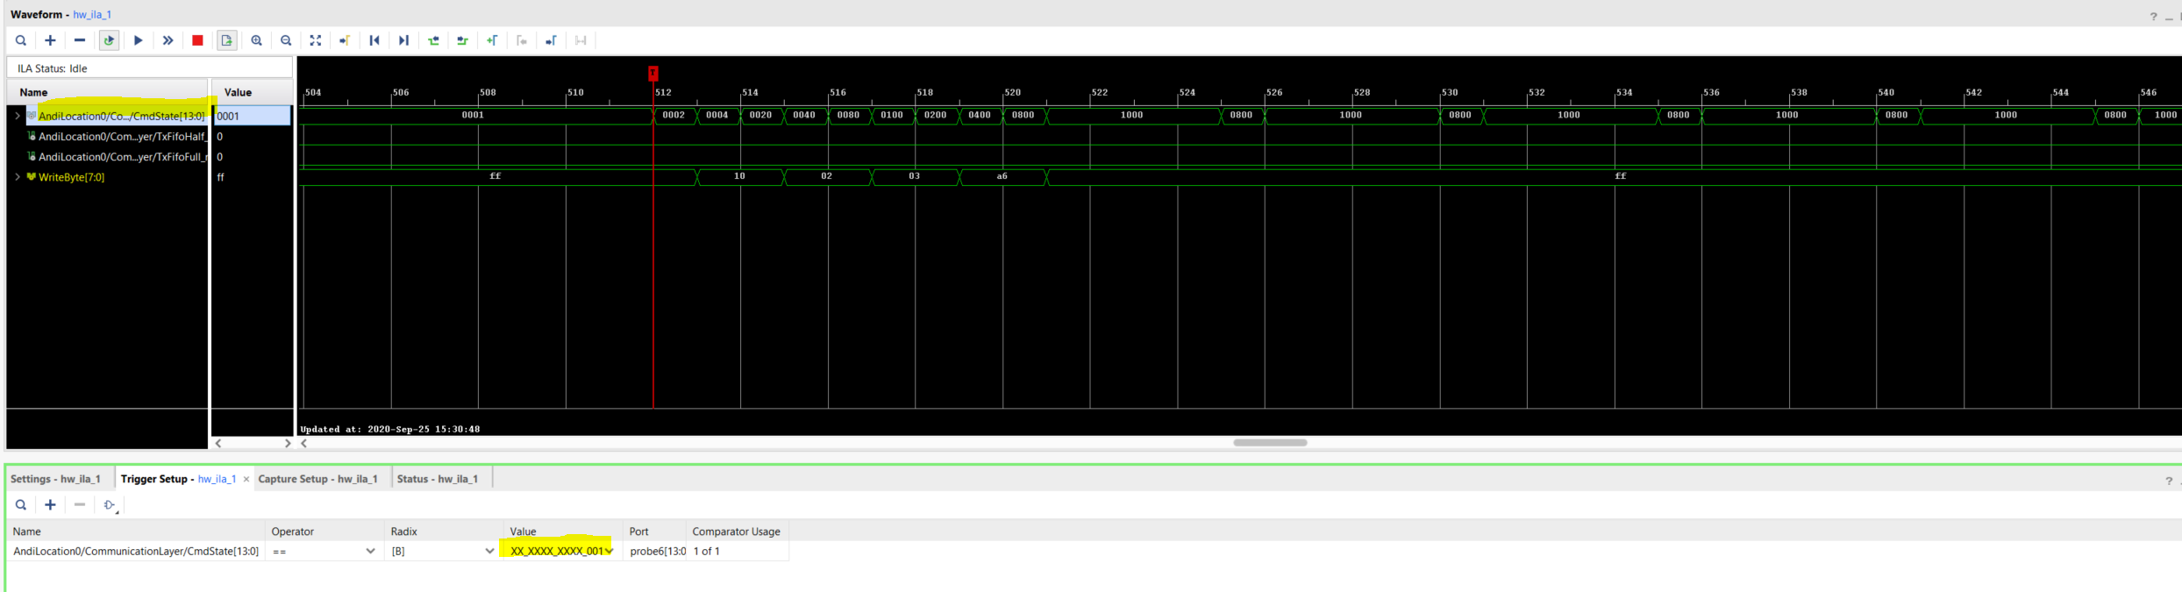
Sample & Triggering on a Std Logic Vector
CmdState sampled & triggered when one-hot encoded state transitions from 0x0001 to 0x0002

Slide 14
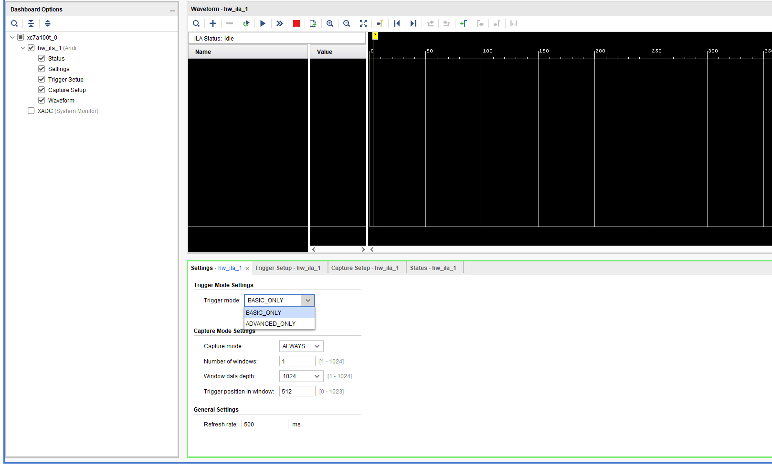

Slide 15
